Slide 1
Mic Box
Mic / Audio switching between Radio and PC allows you to choose:
Using headset with PC while working Radio with external speaker and desk/hand mic
Using headset with Radio while monitoring PC with external speaker
Custom attenuation pad means the headset gain matches the desk mic gain, so no gain adjustments are needed when you switch.
Headset’s electret mic is adapted to expected dynamic mic input.
KO4RON
Ron Craig
Pittsboro, NC

Slide 2
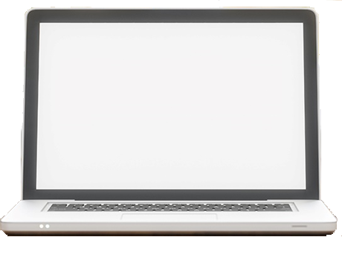
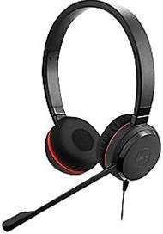
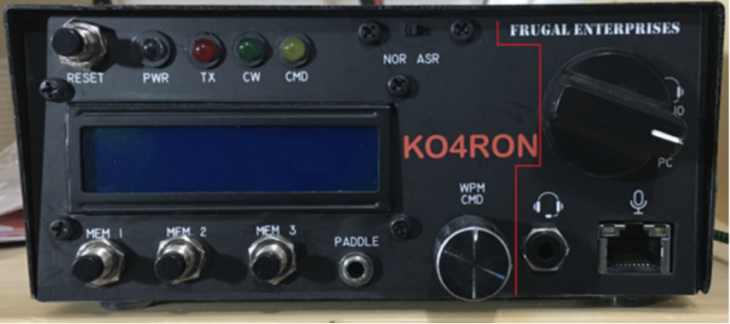
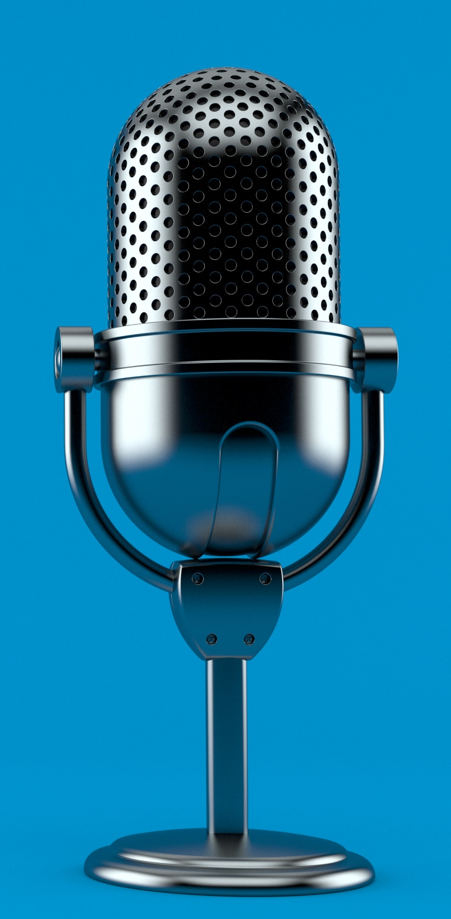
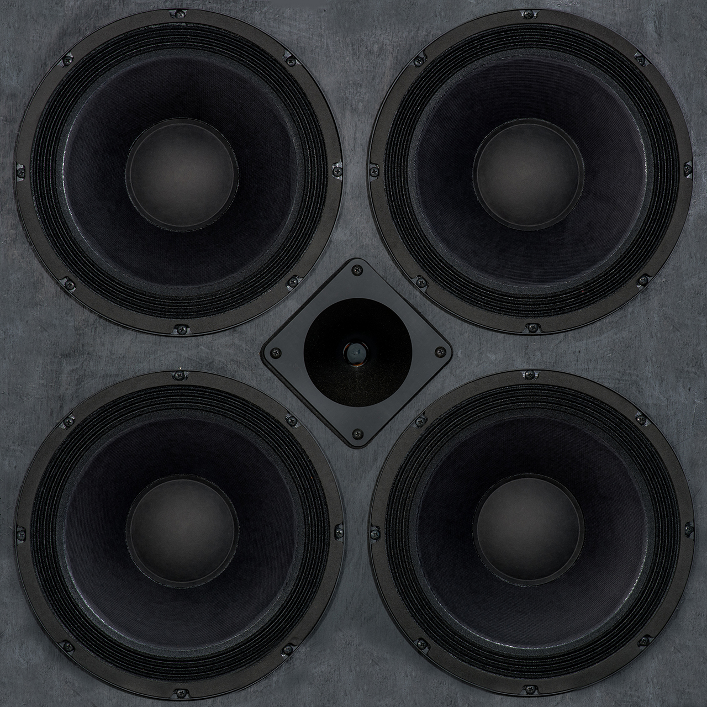
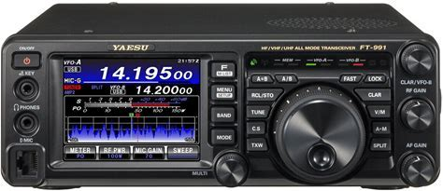
https://groups.io/g/FT-991A/topic/79707944#1220
Notes:
Animated. Click on slide to start it.

Slide 3

Notes:
Animated. Click on “PC” to start it.

Slide 4

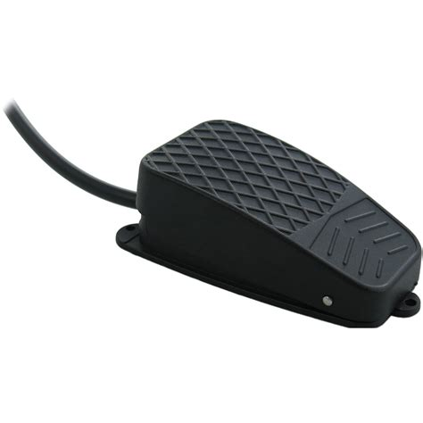
Notes:
Animated. Click on “RADIO” to start it.

Slide 5
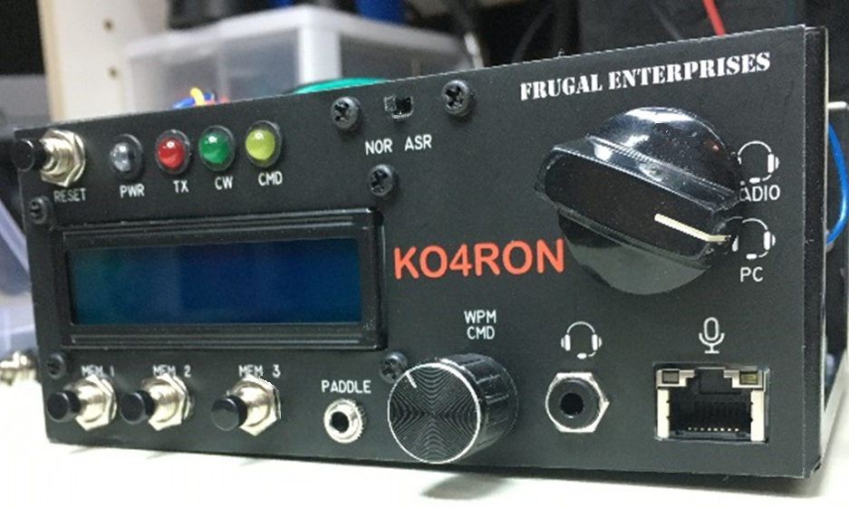
The controls and display and indicators on this side are for the CW keyer.
Rotary switch directs headset to work with Radio or with PC
Headset plugs in here
Handheld mic or Desk mic plug in here

Slide 6
Push To Talk switches
connect here.
PTT 3 supports frequency Up/Down as well.
To external speaker.
From Radio’s Phones jack
To PC’s headphone jack.
To Radio’s Mic jack.

Slide 7
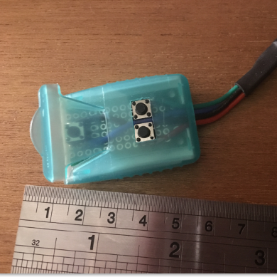
Push To Talk switch in a breath freshener box
I mounted 3 momentary switches on a perf board sized to fit inside a dissolvable breath freshener box.
The lid gives a satisfying positive “click” when pressed.
The other two buttons tune the radio up or down in frequency.

Slide 8
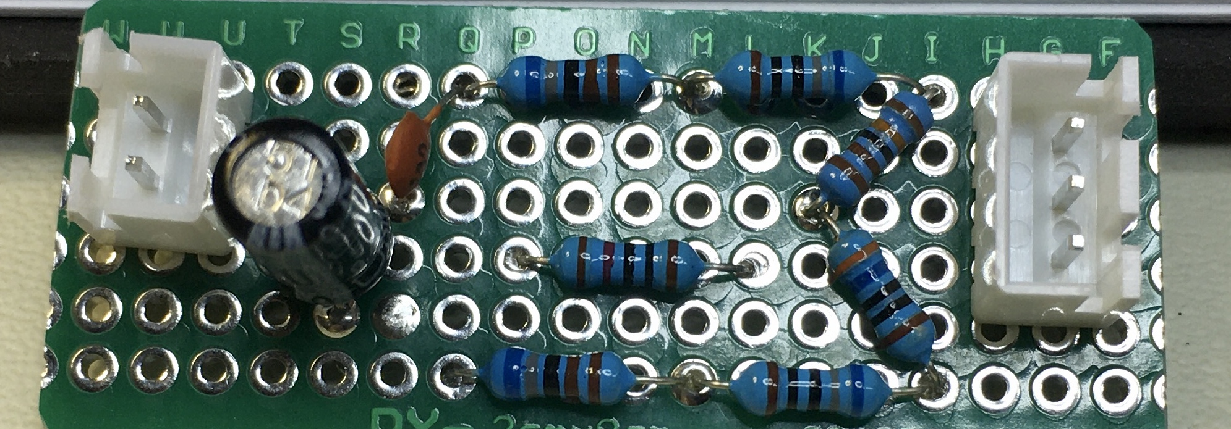
Custom attenuation pad
Adjusts the gain of the electret PC headset mic to match the gain of my hand mic and my desk mic.
This way, no radio adjustments are needed when I switch from headset to hand/desk mic and back.
Without this attenuation, using the headset sounded like I WAS SHOUTING!

Slide 9
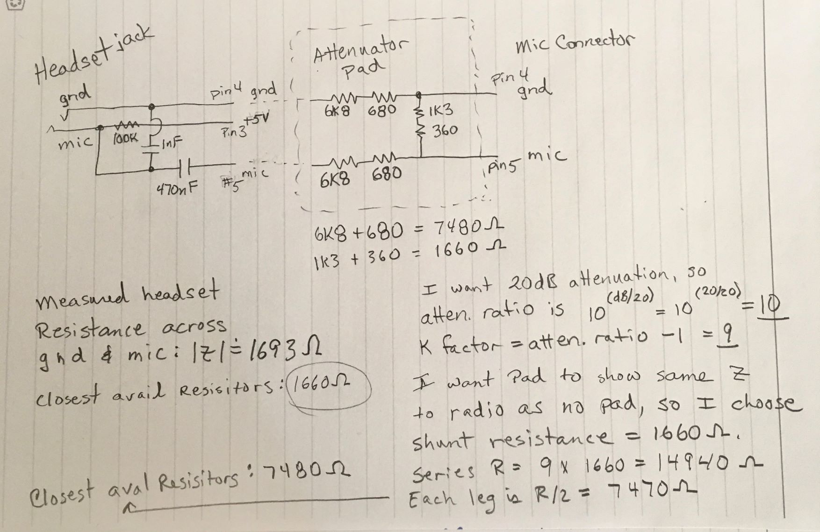
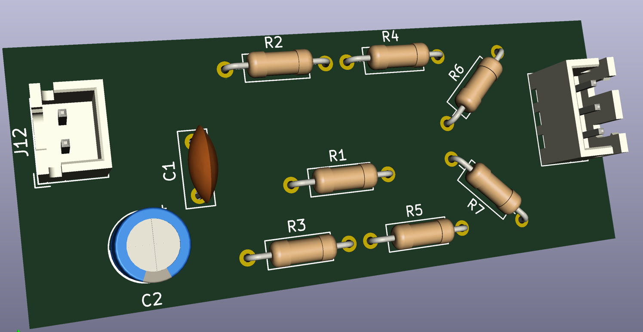
Calculating resistor values for pad
Show your work!
Ref: https://groups.io/g/FT-991A/topic/80740620#1393

Slide 10
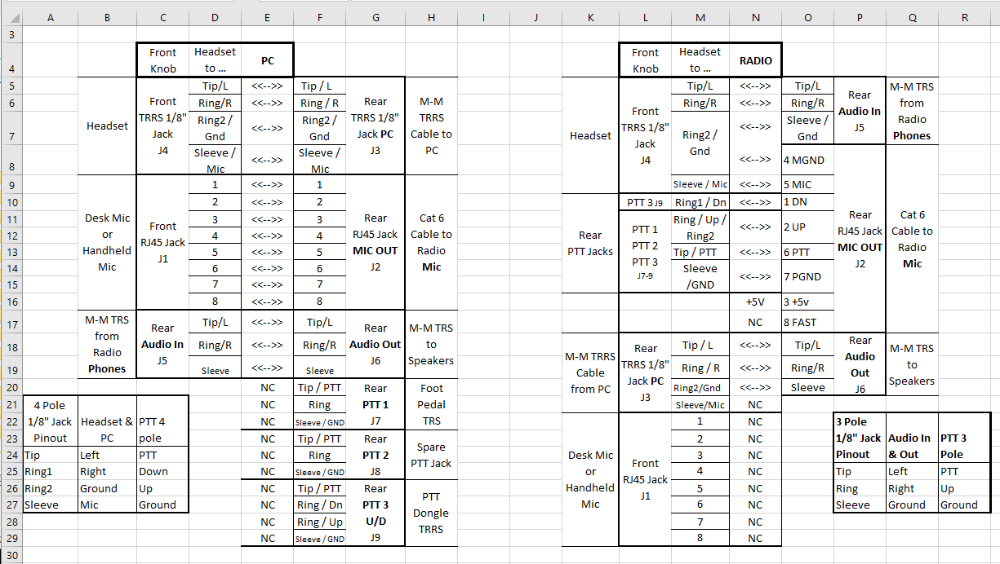

Slide 11
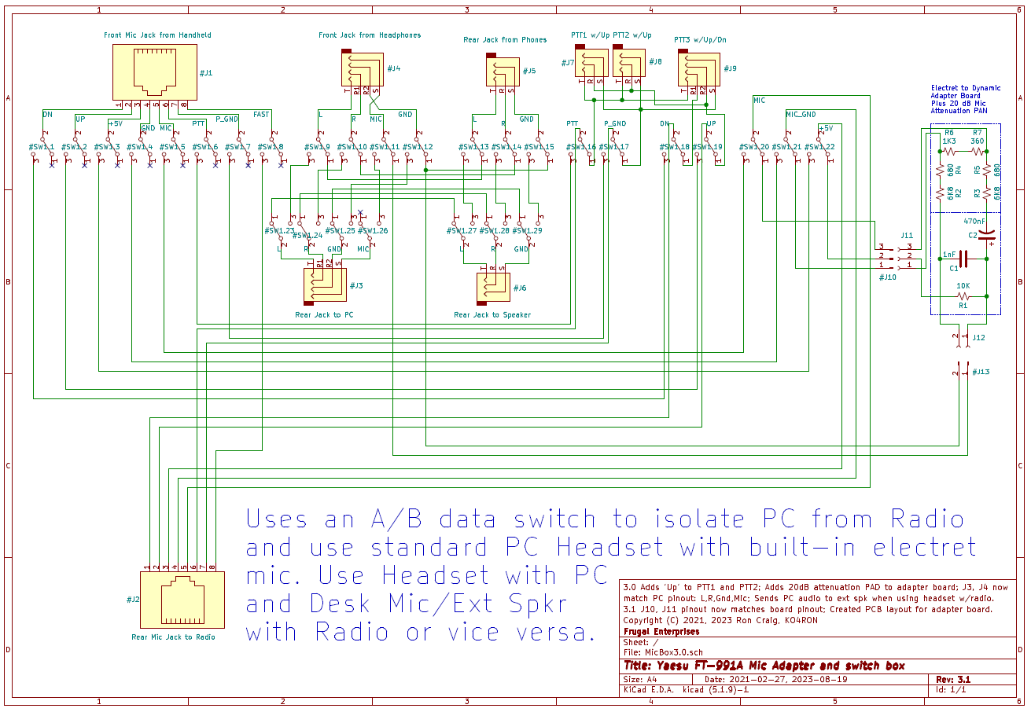
Electret / Dynamic adapter plus 20 dB attenuator PAD is a separate board, so it is easy to remove and change resistance values for a new headset.

Slide 12
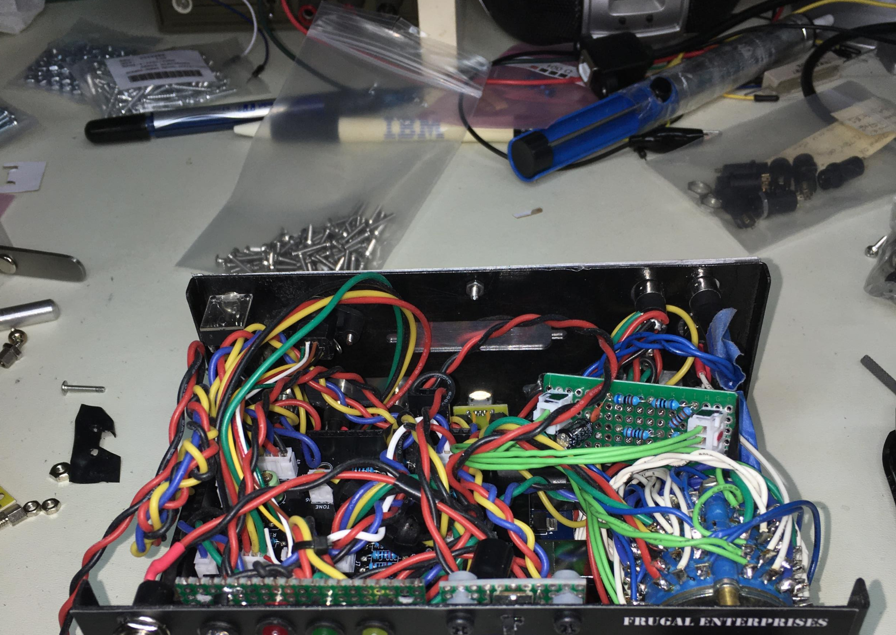

Under the hood
Right ¼ of box contains the rotary A/B switch, the attenuation pad, and the RJ-45 and other connectors needed to do the audio switching. Designed/built Feb-Mar 2021
Left ¾ of box contains Arduino Mega, a custom PCB for the keyer, LCD, speaker and other components for the K3NG-based CW keyer. Designed Dec 2020, Built Jan-Mar 2021
A ground connection was added later for shack’s single point ground.

Slide 13
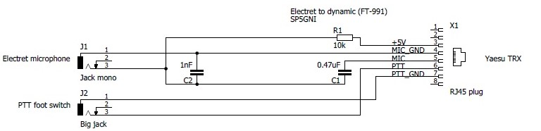
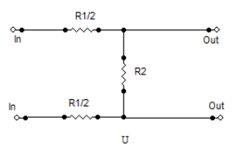
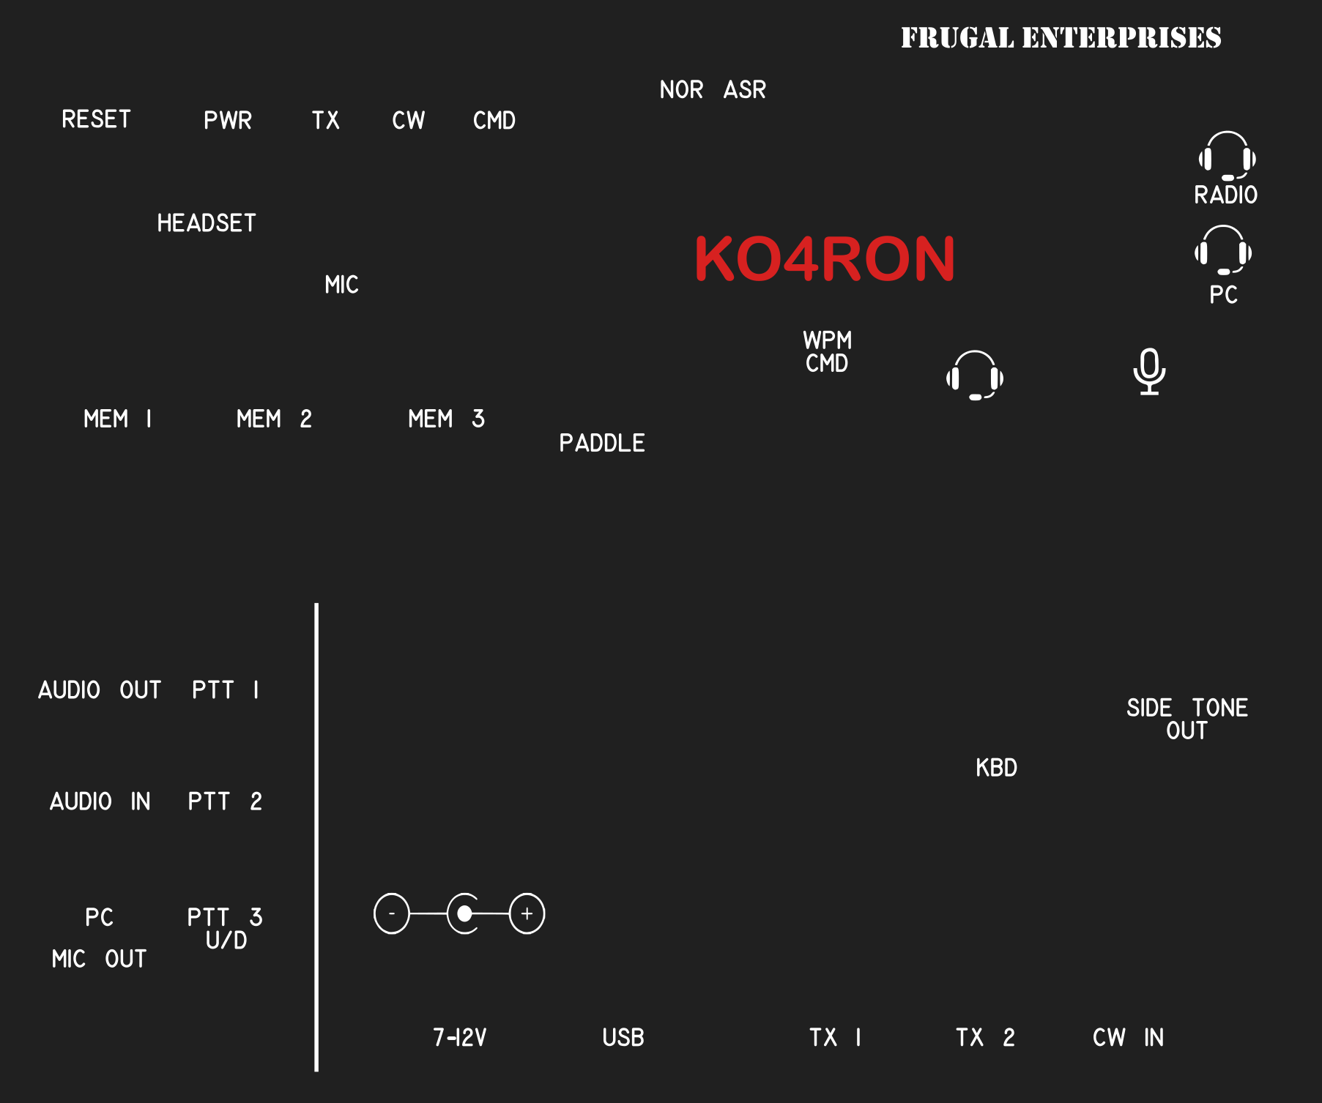
Credits and References
Electret microphone instead of dynamic and vice versa
Miro SP5GNI on HF5L Radio Club site: https://hf5l.pl/en/
All About Pads
Rick Chinn on Uneeda Audio site: http://www.uneeda-audio.com
MakeStickers (panel artwork)
Two stickers (each front & back) were $9
Mic Selector Switch – Geoff N1GY
Inspiration for using an A/B data switch with headset and mic
eBay is where I found an A/B data switch
FT-991A@groups.io is always helpful!

